Slide 1
Title: Task 3 – Dashboard Design
Subtitle: Sales Dashboard using Tableau
Name: Himani Gupta
Date: 25 April 2025

Slide 2
DATASET INFO
Dataset: Sample - Superstore
Source: Kaggle
Records: 9,994 rows
Columns: 21 fields (Sales, Profit, Category, State, etc.)
Tool Used: Tableau Public

Slide 3
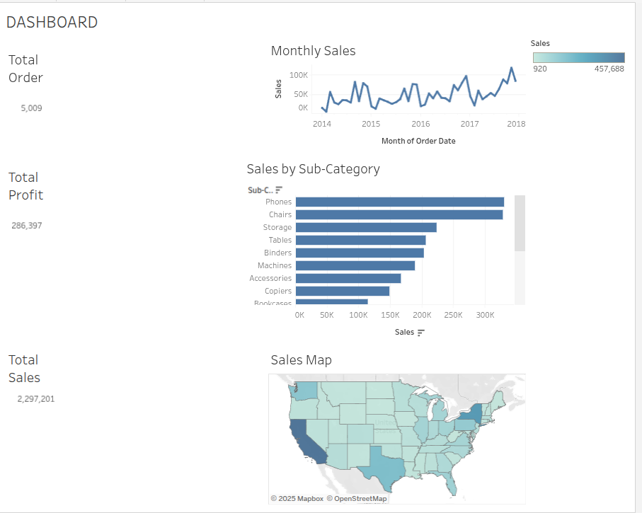
DASHBOARD

Slide 4
KPIs & Visuals Used
KPIs:
Total Sales
Total Profit
Total Orders
Visuals:
Line Chart – Monthly Sales
Bar Chart – Sub-Category Sales
Map – State-wise Sales
Filters:
Category
Segment
Region

Slide 5
Insights
1. Phones were the top-selling Sub-Category.
2.California had the highest sales among states.
3.Sales increased steadily from 2015 to 2018.

